Slide 1
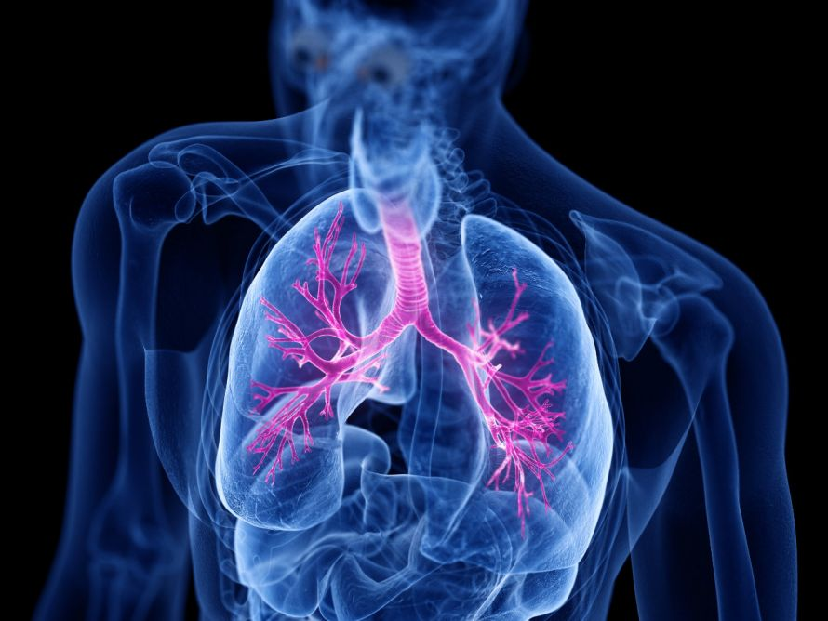
Asthma and COPD Detector using Esp-32
By Uryaswi Bhowmick

Slide 2
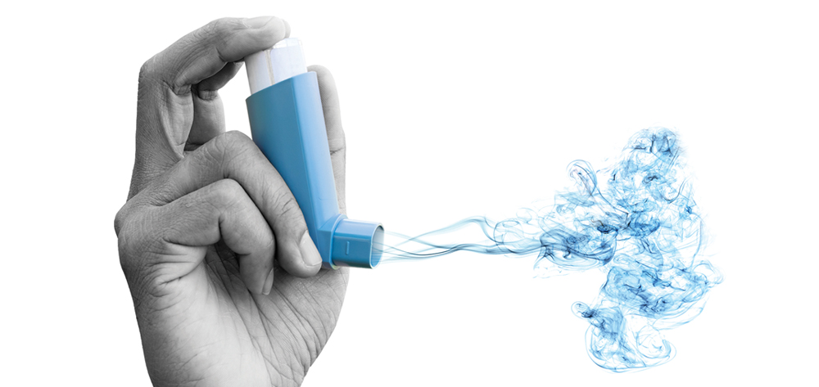
INTRODUCTION
Asthma and COPD are both chronic respiratory diseases that are increasing in prevalence worldwide, affecting millions of people. Asthma, characterized by airway inflammation and narrowing, is more common, while COPD, primarily caused by smoking and characterized by airflow obstruction, is a leading cause of death. Increased awareness, improved diagnosis, and addressing risk factors like smoking and air pollution are crucial to managing these conditions and reducing their impact
Both asthma and COPD are on the rise globally, posing a significant public health challenge where Asthma affects about 262 million people globally and COPD causes about
3.2 million deaths globally

Slide 3
Problem Statement
Asthma and Chronic Obstructive Pulmonary Disease (COPD) are progressive respiratory conditions that are highly sensitive to environmental triggers such as air pollution, temperature fluctuations, and atmospheric pressure. Despite the growing prevalence of these diseases, especially in urban and polluted regions, most patients lack access to continuous, real-time monitoring systems that can detect early warning signs and prevent exacerbations.
Current healthcare solutions are often reactive rather than proactive, relying on manual symptom tracking and occasional checkups, which are insufficient for timely intervention. There is a critical need for a smart, low-cost, and portable system that can continuously monitor environmental and health parameters and alert users to potential risks.
This project addresses this gap by developing an IoT-based solution using ESP32, environmental sensors, MQTT protocol, and a mobile app to enable real-time data acquisition, anomaly detection, and patient alerting — aiming to empower patients and caregivers with actionable health insights.

Slide 4

Objective
Real-time Monitoring: Continuously monitor environmental parameters such as temperature, pressure, and air quality using ESP32 and sensors (e.g., BMP280 and MQ135).
User Health Input: Allow patients to manually input symptoms like dry cough, throat irritation, or wheezing via the mobile application.
Environment-Based Alerts: Detect when environmental conditions become unfavorable for asthma or COPD patients and immediately trigger alerts via a buzzer connected to the ESP32.
Remote Communication: Establish seamless, bi-directional communication between the ESP32 and the Android mobile app using the MQTT protocol for real-time data transmission and alerts.
Mobile Visualization: Display sensor data and symptom alerts on the Android app interface, enabling patients to visualize trends and receive timely warnings.

Slide 5
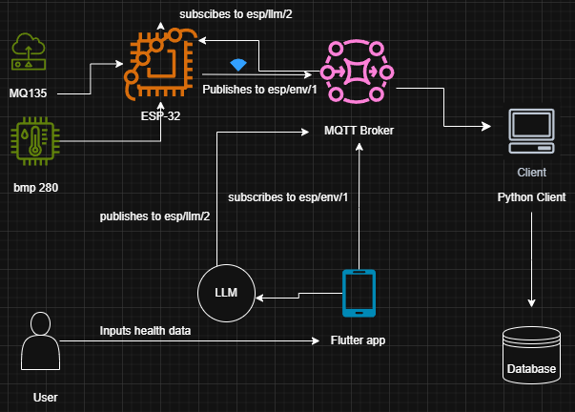
SYSTEM ARCHITECTURE

Slide 6

HARDWARE COMPONENTS
ESP32
MQ135 Air Quality Sensor
BMP280 Sensor
Buzzer
IoT Coach kit
Oled Display

Slide 7

ANDROID APP FEATURES
Real-time dashboard for sensor readings
Graphs for monitoring
Alerts for air quality anomalies
Patient suggestions using LLM along with health report generation

Slide 8
ADVANTAGES AND LIMITATIONS
Limitations
Lack of dataset: Due to lack of dataset, an ML model couldn’t be trained for accurate anomaly detection
Requires Heavy Computational Resources (for AI/ML): Advanced features like anomaly detection using machine learning or AI require cloud-based or high-performance computing resources, which may not be feasible on low-power edge devices like the ESP32.
Internet Dependency: MQTT communication requires a stable internet connection for real-time data transmission between the ESP32 and mobile app.
Limited On-Device Processing: The ESP32 has limited memory and processing power, restricting the complexity of onboard algorithms.
Manual Symptom Input: User-entered health symptoms (e.g., cough, throat irritation) are subjective and not automatically sensed.
Advantages
Performs real time monitoring for patients with asthma and copd
Scalable for smart healthcare
Gives suggestion based on environmental data
Alerts user remotely, if an anomaly is detected

Slide 9

FUTURE SCOPE
Add GPS for location-based alerts
Annotate and create our own dataset that includes data from each patient and environmental data
Train AI model correlating patient data and environmental data to predict asthma and copd beforehand
Integrate cloud analytics & reports

Slide 10
THANK YOU

